Slide 1
Introduction to Apache Spark
Welcome!
Class starts: 9.30 am CDT

Slide 2
Logistics
The training is 3 days long (from Tuesday to Thursday)
Each day we start at 9.30 am central time and planning to finish by 4.00 pm
One-hour lunch break (around noon) and 2 x 20 minutes break in the AM and PM
Please plan to attend to the full training and block your calendar for the entire 3 days

Slide 3
Expectations
Be nice
Be present
Ask questions, be active, use your Instructor as a “resource”
It’s OK to not know everything
Even for the Instructor!
Give feedback

Slide 4

Meet the Instructor
Software Engineer, Solutions Architect, Consultant and Technical Instructor
10+ years experience in Big Data Analytics, Machine Learning, Cloud and DevOps
Using Hadoop more than 10 years, Spark more than 7 years
Built production Big Data systems processing and storing petabytes of data
Research background in Distributed Computing
Experienced technical instructor
NobleProg partner trainer
AWS Authorized Instructor – certified by AWS Training&Certification
Andras Garzo
andras@connected-society.us

Slide 5
Course Outline
1
Introduction to Spark: History and Concepts
2
Working with unstructured data
3
Working with structured data
4
How to write production Spark code
5
Running Spark jobs in distributed environment

Slide 6
Course Outline
1. Introduction to Apache Spark (theory)
History, core concepts, Hadoop-vs-Spark
Understand how Spark fits into the Big Data ecosystem
Architecture, RDDs, transformations and actions, DataFrames
2. Writing Apache Spark jobs
Processing unstructured data using the RDD API
Handling structured data with DataFrame API
Spark SQL
User Defined functions
3. Apache Spark in Production
Running jobs in a multi-node environment (AWS EMR)
Testing and troubleshooting
Performance consideration and optimization
Orchestrating Spark Jobs with Apache Airflow
4. Introduction to Advanced Topics
Process streaming data with Apache Spark
Machine Learning with Spark on scale (MLlib)

Slide 7
Introduction to Spark
Apache spark
Core concepts
History
Relationship with Hadoop and other big data technologies

Slide 8
What is Apache Spark?
Unified computing engine and a set of libraries for
parallel data processing on computer clusters
(source: Spark Documentation)

Slide 9
Parallel Data Processing on Cluster
Processing Logic is defined by the user and distributed to the compute nodes by Spark
Data
Data Partition
Processing Logic
Compute Node
Data Partition
Compute nodes may exchange partial results
Result
Data Partition
Compute Node
Data Partition
Processing Logic
Data broken up into multiple chunks, called Partitions, which can “fit” into one processing node
Each data partition is processed by one of the compute nodes

Slide 10
Spark as a Computing Engine
Driver Process
Executors
Spark Session
User Code
Cluster Manager

Slide 11
Extensibility
No tight coupling with the storage solutions
Spark focuses on the compute only
Connectors are available for a variety of external data sources
And you can add more

Slide 12
Spark as a Unified Analytics Engine
Spark SQL and Structured API (DataFrames)
Spark Streaming (Structured Streaming)
Machine Learning (MLlib)
Graph Processing (GraphX)
Spark Core
Scala
Java
Python

Slide 13
Where Spark is coming from?
Functional Programming perspective
“Traditional” Big Data processing perspective

Slide 14
What the “map” function does? (Back-up slide)
map(lambda a: a * 2)
1
2
3
4
Element-wise operation
2
4
6
8
Run on Node #1
Run on Node #2
Easy to parallelize (but data needs to be distributed among nodes first)

Slide 15
What the “reduce” function does? (Back-up slide)
reduce(lambda a, b: a + b)
reduceByKey(lambda a, b: a + b)
1
2
3
4
Bob
1
Jim
2
Bob
3
Jim
2
+
3
3
4
Bob
1
3
Jim
2
2
reduce(lambda a, b: a + b)
+
6
4
Bob
4
Jim
4

Slide 16
Why Hadoop Map/Reduce is often slow? (Lack of In-Memory Processing Capability)
Input Data
Result
Hadoop Map/Reduce Job
Hadoop Map/Reduce Job
Hadoop Map/Reduce Job
Local Disk
Local Disk
Local Disk
Hadoop Map/Reduce Job
Iterative Jobs

Slide 17
Datalake
Data Warehouse
Operational Datasets
Aggregated data for reporting and ad-hoc analytics
Extract / Transform / Load
(Spark)
Redshift / Teradata / Greenplum / Oracle
Logs
Unstructured or semi-structured data
Historical Data
Event Stream
HDFS / S3
Not latency sensitive ad-hoc analytics on top of high-resolution data Spark/Drill/Impala/Athena/Presto
HDFS / S3

Slide 18
Distributed Resilience Datasets
How spark achieves parallelism?

Slide 19
“Data Structures” in Spark: Resilient Distributed Dataset (RDD)
RDD
For structured and unstructured data
Can come from any data source
Familiar object-oriented programming style
Compile-time type safety (scala only)
No inbuilt optimization engine, for structured data it can be less performant
Scala/Python obj.
Scala/Python obj.
Scala/Python obj.
Scala/Python obj.
Scala/Python obj.

Slide 20
Resilient Distributed Dataset
Memory
Partition
Memory
Partition
Memory
Partition
Partition
Partition
Partition
Data chunks which cannot fit into memory will be spilled to the local disk
Partition
Partition
Partition
Node #1
Node #2
Node #3
Partition
Partition
Local Disk

Slide 21
Resilient Distributed Dataset
Executor #1
Executor #1
RDD #1
Some Transformation
RDD #2
Oh, no! Some failure happened
Data Source
But no worries, we just need to re-compute this branch
Executor #2
Executor #2
RDD #1
Some Transformation
RDD #2

Slide 22
Transformations
Working with dataframes
Transformations
Actions
end-to-end data processing

Slide 23
DataFrames
Most common structured API
Represents a table of data with rows and columns
Think of a spreadsheet but it can be partitioned across multiple nodes

Slide 24
“Data Structures” in Spark: DataFrames
DataFrame
Data is organized to rows and columns
For structured or semi-structured data only
AVRO, CSV, JSON, relational databases
Schema needs to define prior ingestion, but Spark can infer the schema if needed
Provides a higher-level API abstraction
For querying, you can use SQL too
Many types of error can be caught at run-time only
In-built optimization engine

Slide 25
What is a transformation
You can express your data processing logics via transformations
You cannot change the individual elements in an RDD or a row in a DataFrame
Remember: these are immutable data structures
Every transformation will result a new RDD/DF
You can pipe together multiple transformations which allows Spark to optimize the execution
Transformations are lazy:
Does not execute before we won’t call an action
Example actions: take(…), collect(), save()
RDD
or DataFrame
RDD
or DataFrame
RDD
or DataFrame

Slide 26
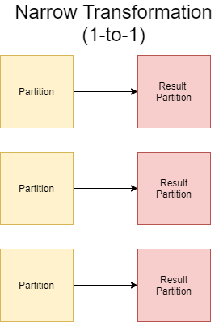
Transformation Types: Narrow Transformation
Each input partition contributes to one output partition only
Examples:
Map: apply the same transformation logic for each row
Filter/where: select specific records from RDD/DF
Projection: selecting/adding/filtering column for a DF
Easy to parallelize, independent executors does not need to exchange data (no shuffling)
Multiple narrow operations can be pipelines and can be performed in-memory

Slide 27
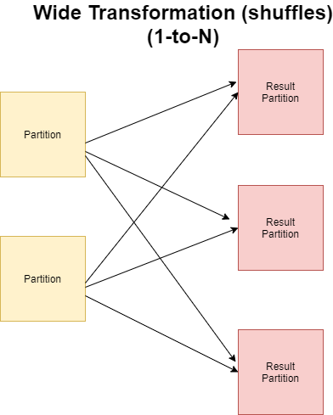
Transformation Types: Wide Transformation (Shuffles)
One input partition contributes to many output partitions
Referred as Shuffle operation, as Spark needs to exchange partitions across the cluster
Multiple wide transformations cannot be pipelined
Transformations involving data shuffling:
Group-by
Sort

Slide 28
Structured API Execution
Physical Plan
SQL
Catalyst Optimizer
Steps:
Write DataFrame code or SQL expression
Spark converts it into a Logical Plan
Spark transforms the Logical Plan into a Physical Plan while perform optimizations where it is possible
Spark executes the physical plan (sequence of RDD manipulations)
DataFrames
Datasets

Slide 29
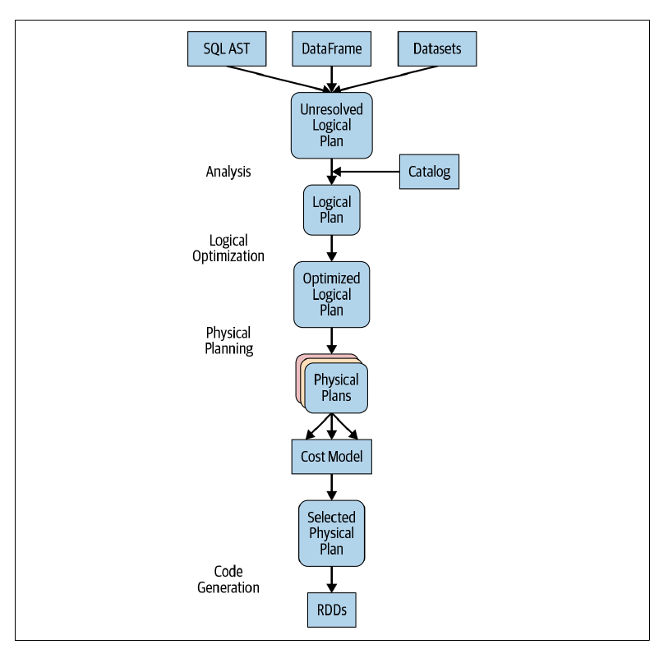
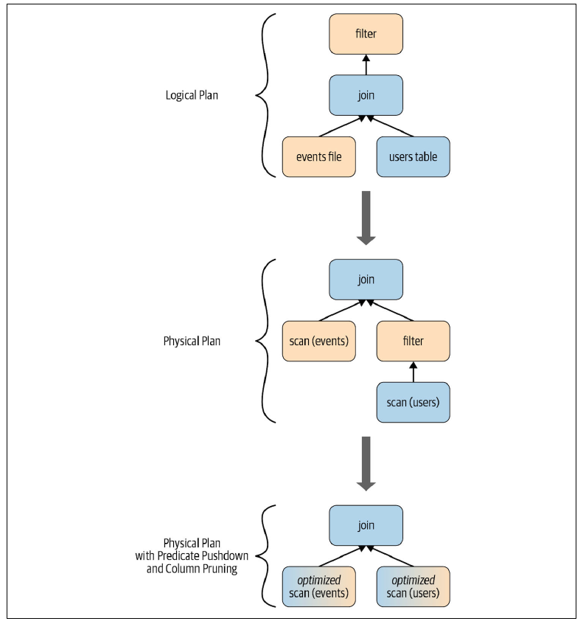
Execution Planning

Slide 30
Spark SQL

Slide 31
Spark SQL
Spark Application
JDBC/ODBC
SparkSQL Shell
Catalyst: converts computational query into an execution plan
Tungsten: enables efficient memory management, stores data rows outside of the JVM (off-heap) in a column-based memory layout
Spark SQL
Catalyst
Tungsten
JSON
PQ
Avro
ORC
Hive Tables

Slide 32
DataFrames vs SQL
SQL
DataFrames
Syntax
Errors
Runtime
Compile time*
Semantic
Errors
Runtime
Runtime
* In case of Scala. In python, Syntax errors will be revealed during Runtime as well

Slide 33
Input/Output

Slide 34
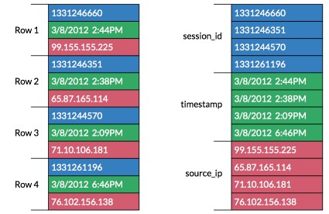
Columnar File Format
Values from same columns are grouped and stored together
As values has the same type, it can be stored in a more compact way than the individual records
To scan through all the values of a specific column, you don’t need to read the entire table
Significantly can speed up query time
Most prevalent columnar formats:
Parquet (PQ)
ORC

Slide 35
Partitioning
Timestamp
Name
TS = [1, 2, 3]
1
Bob
1
Bob
2
Alice
2
Alice
Table is partitioned based on values of the Timestamp column
3
Bob
3
Bob
4
Bob
TS = [4, 5, 6]
4
Bob
5
Alice
5
Alice
6
Alice
6
Alice
Column used for Partitioning

Slide 36
Bucketing
Timestamp
Name
Hash(Name)
Hash = 0
1
Bob
1
Bob
0
3
Bob
2
Alice
1
4
Bob
3
Bob
0
4
Bob
0
Hash = 1
2
Alice
5
Alice
1
5
Alice
6
Peter
1
6
Peter

Slide 37
Partitioning vs Bucketing
Use partitioning when your output data will be filtered based on the partitioning column
E.g. time, country code, product type, etc.
Pick a column which has small cardinality (e.g. user_id is not a good choice!)
You can have multiple layer of partitioning, e.g. first by time and after product_id
But don’t overuse! You may end up large number of small files which is bad from I/O perf. Aspect
Use Bucketing when you want your result dataset to be joined based on the bucketing key by a subsequent data processing job
Set the number of partitions wisely

Slide 38
Before Writing
E1
Partition
Write Task
File
Partition
Write Task
File
E1
Partition
Write Task
File
Partition
Write Task
File
Partition
Write Task
File
Output file size should be in an optimal range, too many or too large files are not beneficial
Data Frame / RDD
Storage

Slide 39
Pattern: repartition before writing
E1
E1
Partition
Write Task
File
Partition
Partition
Write Task
File
E1
E1
Partition
Partition
Write Task
File
Partition
Write Task
File
Unbalanced Data
Reportioned Data
Storage

Slide 40
Pattern: Coalesce() before writing
E1
E1
Partition
Partition
Partition
Write Task
Partition
File
E1
E1
Partition
Partition
Partition
Partition
File
Write Task
Partition
Unbalanced Data
Coalesced Data
Storage

Slide 41
Best Practices
Write the data down in columnar format (e.g. PQ) when there are subsequent analytical queries/jobs (SELECT … WHERE… GROUP BY..) likely will run on top of the result dataset
Analytical queries can benefit a lot from the columnar representation, especially when the table is wide (many columns) but you need just a subset of the columns (column numbers are limited in the “SELECT”)
Use partitioning if you know the result dataset will be filtered along with a specific column
Use bucketing if the result dataset will be joined based on the bucketing key/column
Output partition file sizes should be in the sweet spot, around 100 – 200 MB uncompressed
You may need to repartition / coalesce your dataframe before writing

Slide 42
Joins

Slide 43
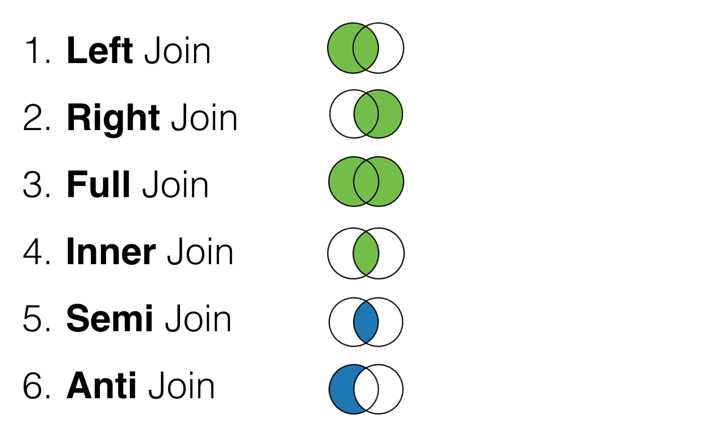
Join Types
Inner Joins: keep rows with keys that exist in both (left and right) tables
Outer Joins: keep rows with keys either in left or right tables
Left outer joins: keep rows with keys in the left table
Right outer joins: keep rows with keys in the right table
Left semi join: keep the rows in the left table where the key appears in the right
Left anti joins: keep the rows in the left where they do not appear in the right table

Slide 44
Join Strategies in Spark
Broadcast Hash Join (BHJ)
Shuffle Hash Join (SHJ)
Shuffle Sort Merge Join (SMJ)
Broadcast Nested Loop Join (BNLJ)
Shuffle-and-replicated nested loop join (aka. Cartesian product)

Slide 45
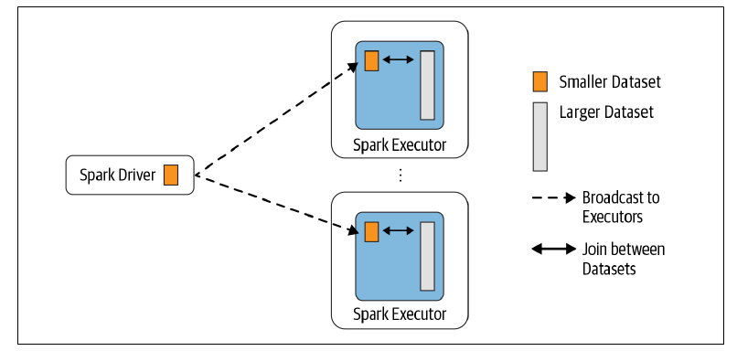
Broadcast Hash Join
One table is much smaller, fits into the memory on one node
Threshold for BHJ can be configured, by default it is 10 MB
Use “broadcast” keyword to give a hint for Spark to Broadcast Join
May not be enforced

Slide 46
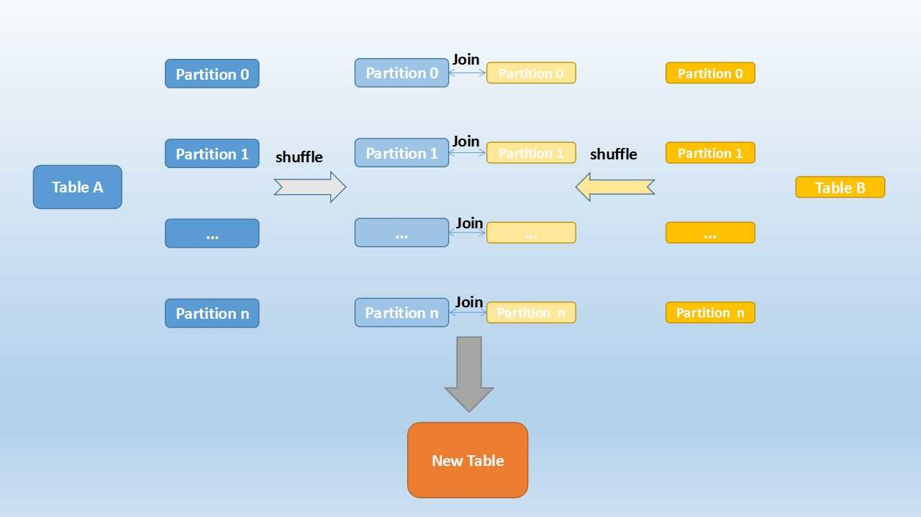
Sort-Merge Join
Shuffle phase: re-partioning by key
Sort phase: sort partitions by key
Merge Phase
You can speed it up if you have co-located partitions

Slide 47
Performance Tuning

Slide 48

Parallelism and Performance
Spilled to Disk
Task
Task
If one or more Partition cannot fit into the Executor’s memory, it will be stored on disk and waiting for an idle CPU core to be processed You want to avoid this, because reading/writing from disk is slow and you lose the “momentum”
Partition
Processing records one by one
Partition
Partition
This can be efficient if all your data is in memory. However, if you need to touch the disk, your performance degrades
Memory
Partition
Task
Partition
Task
CPU cores allocated to one Executor
You do not want to have idle CPU cores in an Executor during processing. The number of partitions per Executor should match with the number of cores. This will give you the highest throughput
Partition
Task
Map phase (e.g. map(), filter() operation, WHERE closure, etc.) on one Executor

Slide 49
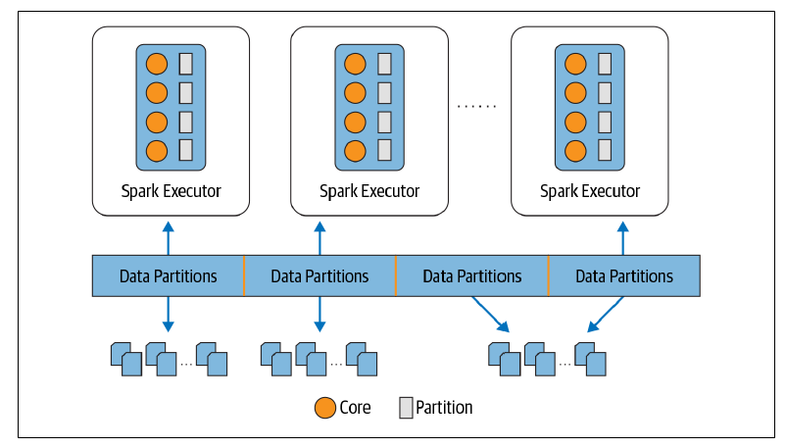
Partitions and Parallelism
Partitions are the atomic units of parallelism
Increase Partition => Higher parallelism => Improved Resource Utilization
However, too small and big partitions also can degrade Job performance
Ideal case: #Partitions = #cores
Ideal Partition Size: 128 – 256 MB

Slide 50
Shuffling Deep Dive
E1
E2
E3
Partition 1
Partition 2
Partition 3
Initial Phase: underlying RDD consisted of 3 partitions stored on different executors
E1
E2
E3
Pre-Shuffling Phase: all partitions are divided into a configurable fixed number of partitions based on the hash value of the “shuffling key”
Number of shuffling partitions controlled by spark.sql.shuffle.partitions You need to tune it manually and see what value gives the best performance results!
Data Shuffling
E1
E2
E3
Shuffling Phase: the corresponding partitions are moved together one specific executors and new partitions are formed

Slide 51
Most impactful configurations
Number of maximum Executors (in case of dynamic execution)
Number of CPU cores per Executor
Amount of Memory per Executor
Number of shuffling partitions (spark.sql.shuffle.partitions)
Number of input partitions
Can be tuned as a spark-submit argument
Can be tuned as a Job configuration
Depends on the input data. If it is not partitioned well, consider to repartition before processing

Slide 52
Executor CPU core vs Memory
Always look the Memory / CPU core ratio.
The sweet spot is between 2 – 4 GB
Executor Memory should not exceed 32 GB
You should not give too many CPU cores for one executor. Rather run multiple executors on one single node
Requires some testing, but the sweet spot is around 4 or 6. Too many CPU cores can cause contention among the internal threads and the overall Executor performance tends to degrade

Slide 53
Writing Production Spark Code
Goals:
Putting everything together what we learnt
Write a complex scalable data pipeline in spark which interacts multiple data sources and databases
Learn how to write production spark code with tests
How to optimize your job at scale

Slide 54
Task: Process Apache access log files
100s of GB Apace HTTP server access.logs generated every day
You need to implement a horizontally scalable solution, when you can process the new log files each day
The security team needs to get some basic statistics, like number of HTTP error codes per server or resource. This aggregated data need to be stored in a relational data warehouse as they need instant and quick access
The sanitized and structured data needs to be stored on a Data Lake and can be queried via SQL in case an incident happens and needs the raw data for the investigation
Some events also can trigger alarms. For example, if in an hour window several specific error codes suddenly exceeds a pre-defined threshold, a notification needs to be raised

Slide 55
Solution Outline
alarm_df
Spark Based Data Processing Pipeline
Notification Service
“Calculate” Alarms
Input Folder
Trigger
Extract and Transform
Daily data dumped into an S3 bucket
Aggregate and Load
stat_df
log_df
MPP Query Engine
Datalake
DWH

Slide 56
Generic Advices
Test your code locally before deploying
Use Spark only when it is necessary (less is often more!)
Mind your dependencies
You need to deploy along with your Driver code
Dependencies can be loaded from S3/HDFS to executors which can speed-up the Job starting time
De-couple data pipeline and I/O

Slide 57
Testing Best Practices
Work your local dev. Environment first
Always test your pipeline locally
… But don’t forget the end-to-end test in real production-like system
Test your job with:
Developer defined data
Sampled data from production system
Generated data (statistics for sampling derived from production)
Get exact input/output datasets from business and integrate with continuous testing

